Slide 1

ALY 6000: Introduction to Analytics Module 6 Data Analysis Assignment
COVID-19 and its Impact on Students A cross-sectional survey is conducted with a sample size of 1182 students of different age groups from different educational institutions in Delhi National Capital Region (NCR) to understand the impact of COVID-19 on education, social life, and mental health of students
Devi Somalinga Bhuvanesh
NUID - 001428225

Slide 2
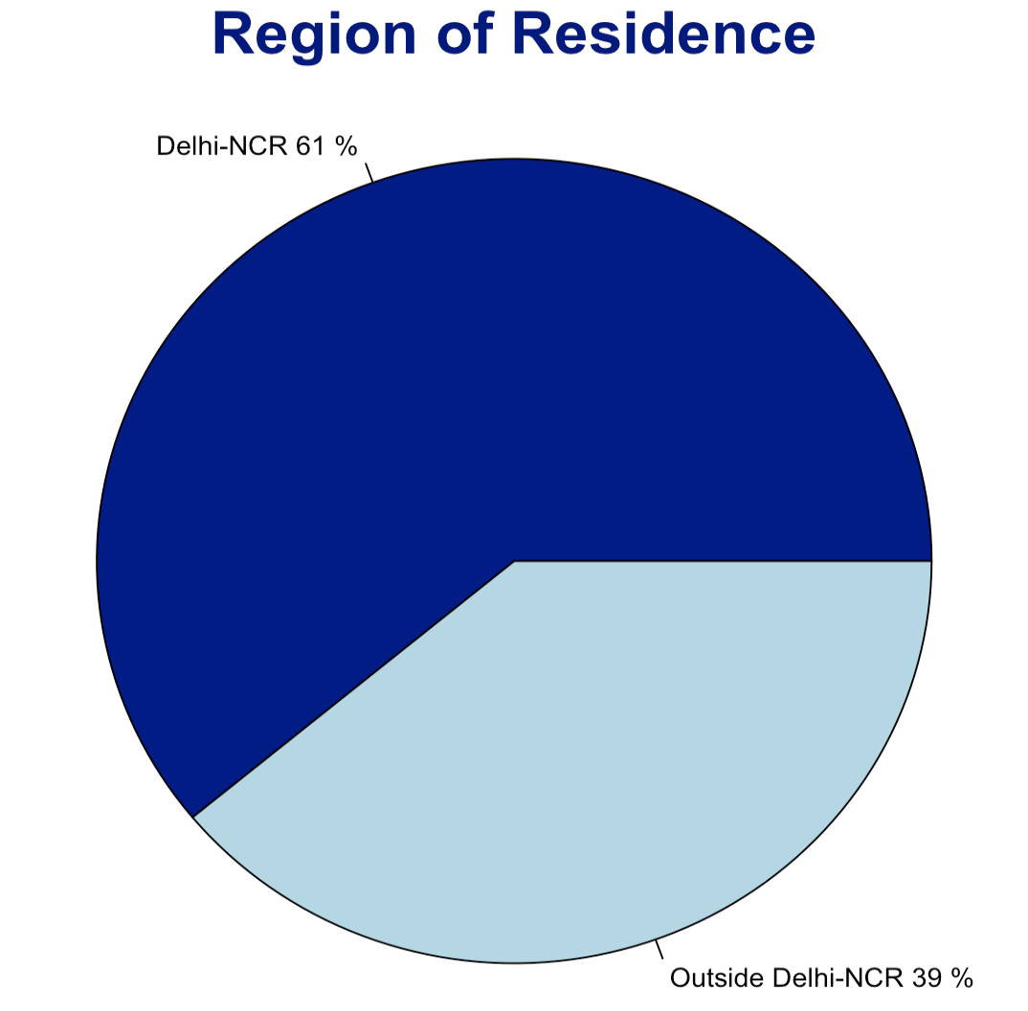
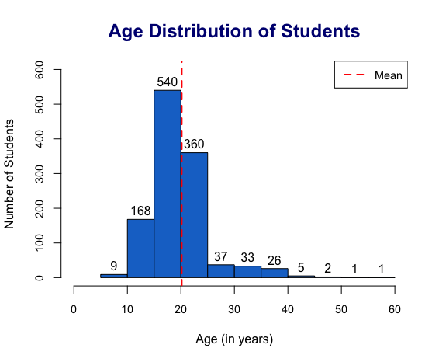
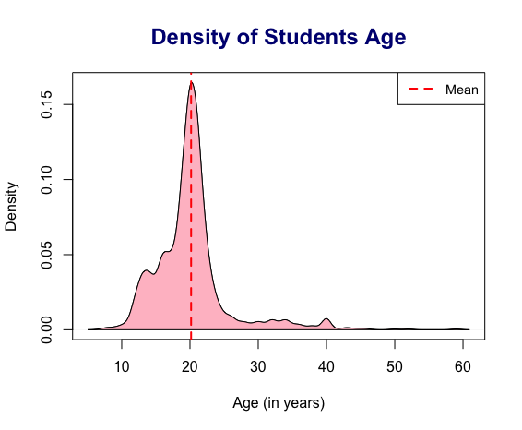
Region and Age
The survey was attended by students of all age group ranging from 7 years to 59 years old.
With the average age of students with 20 years old, 46% of the students belong to 15-20 years old followed by 20-25 years old (30%).
Only 1% students are below 10 years old as well as above 40 years of age.
The age group distribution indicates positive skewness with 1.94, i.e., more values fall in the left side and it also has high peak with kurtosis value of 9.94.
Out of 1182 students who attended survey, 61% (721) are from Delhi-NCR region, i.e., from urban setting while 39% (461) are from other region. ​

Slide 3
Research Questions
Based on the statistical analysis and survey design, below are the following questions:
How has Covid impacted students' daily life, education system, and physical and mental health?
How has Covid impacted different age groups?

Slide 4
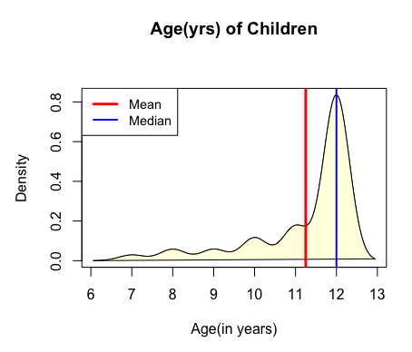
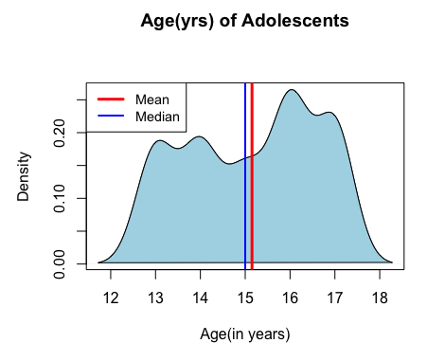
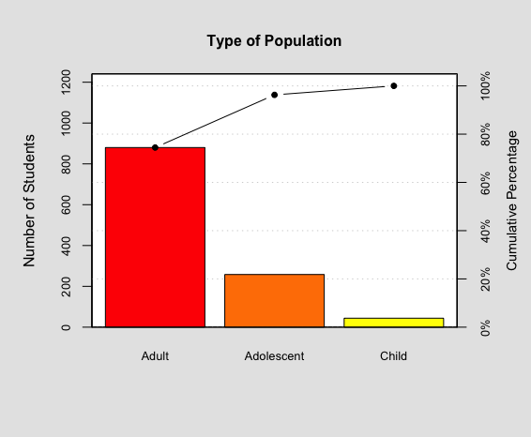
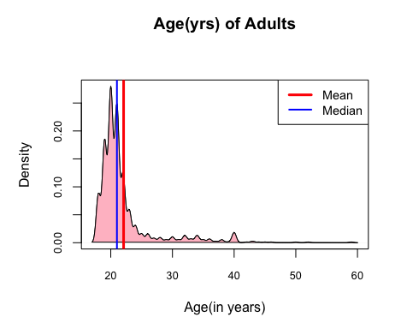
Type of Population (new variable)
The age range of children are from 7 to 12 years old with an average of 11 years, adolescents are from 13 to 17 with an average of 15 years, and adults are from 18 to 59 years with an average of 22 years.
The age distribution of children and adolescents are negatively skewed with value of -1.77 and - 0.18 respectively which indicates more values in the right side. On the other hand, it is positively skewed for adults with value of 2.93, i.e., more values in the left side.
Children age group almost has a normal distribution with Kurtosis value of 2.64 and the highest peak is seen in adults with Kurtosis value of 10.20. Adolescents have negative Kurtosis with value of –1.34.
A new variable on "Type of Population" has been created based on the age of students provided in the dataset.
It was found that
74% of the students are adults. - 18 years and more (880)
22% are adolescents. - 13 to 17 years (258)
4% are children – 7 to 12 years (44)

Slide 5
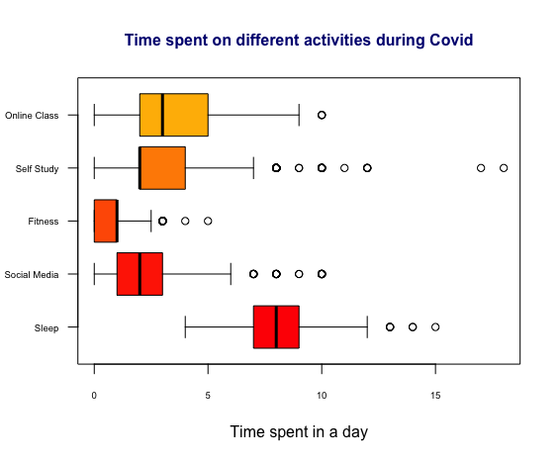
Covid Impact on Daily Activities
Type of Activities | Time Range (Min and Max) | Average Time spent | Skewness | Kurtosis
Online Class | 0-10 | 3.20 | 0.36 | 2.71
Self-Study | 0-18 | 2.91 | 1.73 | 8.42
Fitness | 0-5 | 0.76 | 0.96 | 4.57
Social Media | 0-10 | 2.36 | 1.69 | 6.84
Sleep | 4-15 | 7.87 | 0.73 | 3.99
In 24 hours, on an average, a student has spent 3 hours each on online class and self-study. Around 2 hours was spent on social media, and they had 7-8 hours of sleep. 1 hour of time was spent on fitness.
Through data analysis, it was also observed that out of 1182 students,
133 students did not attend online class (11%)
76 students did not do any kind of self-study (6%)
419 students did not do any fitness activity (35%)
36 students did not use social media (3%)
26 students had sleep less than 7 hours in a day (2%)
On the other hand, it was also noticed that,
40 students (3.38%) attend online class and 54 students (4.56%) do self-study for 8 hours or more in a day.
28 students (2.36%) were able to concentrate on fitness for more than 2 hours a day.
66 students (5.58%) used social media for more than 5 hours a day
305 students (25.8%) slept more than 8 hours a day
Statistical analysis indicates that all the indicators are positively skewed and has positive Kurtosis. Of which, online class seems to have almost normal distribution and self-study has highest peak.

Slide 6
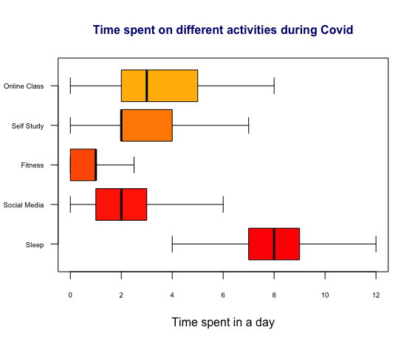
Covid Impact on Daily Activities – Removed Outliers
Type of Activities | Time Range (Min and Max) | Average Time spent | Skewness | Kurtosis
Online Class | 0-8 | 3.15 | 0.25 | -0.57
Self-Study | 0-7 | 2.60 | 0.57 | -0.08
Fitness | 0-2.5 | 0.71 | 0.41 | -0.57
Social Media | 0-6 | 2.16 | 0.86 | 0.19
Sleep | 4-12 | 7.83 | 0.56 | 0.48
After removing Outliers in each activity, the average time spent in each activity has changed slightly.
With comparison to activities with outliers, Skewness and Kurtosis has also reduced.
All activities have positive Skewness but with value less than 1 whereas for Kurtosis, three activities, i.e., Online Class, Self-Study, and Fitness have negative Kurtosis. Normal distribution is not observed in any activity.

Slide 7
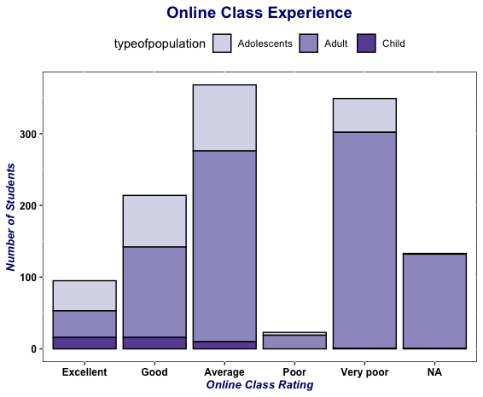
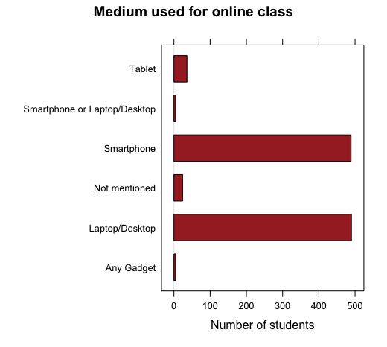
Covid Impact on Education
Overall, the graph indicates that majority of the students felt the online class as Average (368) and Very poor (349).
Out of 44 children, 73% of the students rated the online class experience as excellent (16) and good (16). Around 23% of students have rated as average while only 1 child felt the online class experience as very poor.
Out of 258 adolescents, majority of the students (36%) felt the class was average while 28% felt it was good. One fifth of the adolescents (20%) rated the online class as poor and very poor. Only 16% of the students felt the online class experience as excellent.
Out of 880 adults, 36% rated online class as poor and very poor followed with average rating of 30%. 14% felt the online class as good. Only 4% adults felt the class was excellent.
Majority of the children have found online class experience as excellent and good (73%) while adolescents (56%) and adults (66%) felt it was poor or average.
Overall, 133 students did not attend online class (11%). Out of 1049 students who attended online classes during Covid, 94% (984) chose smartphone or laptop/desktop as convenient medium for attending online class followed with tablet (3%).

Slide 8
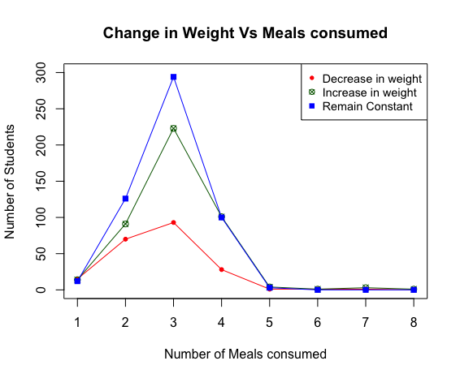
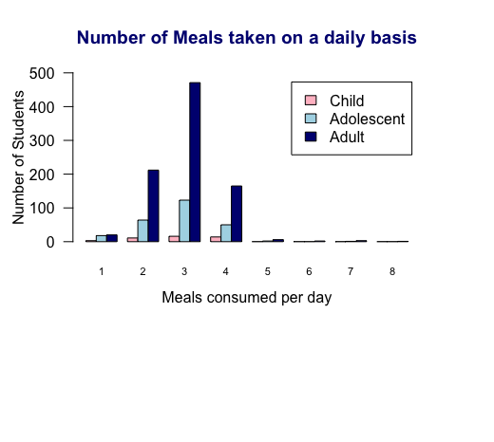
Covid Impact on Physical Health
During Covid, 18% students lost weight, 37% increased weight, and 45% weight remained constant.
15 and 70 students who ate once and twice a day respectively have decreased in weight. However, 124 students who eat thrice or more in a day have also observed decrease in weight which indicates the presence of other health issues.
333 students who ate thrice or more in a day increased weight. In addition, it is surprising to note that 14 and 92 students who ate once and twice a day respectively also increased weight which could be due to lack of physical activity.
397 students who ate thrice or more in a day had maintained same weight. On the other hand, 12 and 126 students who ate once and twice a day respectively also ensured to maintain same weight.
1182 students have consumed meal between 1 to 8 times a day. Of them, slightly more than half of the students (52%) have consumed meals 3 times a day followed with consumption of food twice a day (24%) and 19% consume four times a day.
15 students consumed meals 5 to 8 times in a day. Of them, 3 are adolescents and 12 are adults.
41 students (3.47%) have consumed food only once a day. Of them, 3 are child, 18 adolescents, and 20 adults which could indicate the poor economic level of the families.

Slide 9
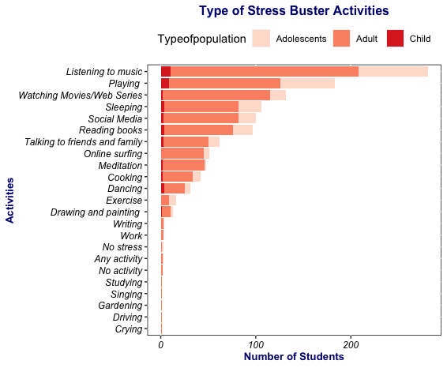
Covid Impact on Mental Health
To relieve from stress during Covid pandemic lockdown, majority of the students listened to music (24%) followed with playing (15%) and watching movies/web series (11%).
Children are kept occupied by music (23%), playing (20%), reading books (9%), dancing (9%), and sleeping (9%).
Adolescents preferred listening to music (28%), playing (22%), sleeping (9%), reading books (8%), and social media (7%).
Adults engaged themselves majorly by listening to music (23%), playing (13%), watching movies/web-series (13%), social media (9%), and sleeping (9%).
However, 2 adults and 1 adolescents did not feel any stress.

Slide 10
Key Findings
Out of 1182 students who attended survey, 61% (721) are from Delhi-NCR region., i.e., from urban setting having an average age group of 20 years old. 74% of the students were adults (880), 22% were Adolescents (258), and 4% Children (44) were present in this survey.
11% of the students did not attend online class which indicates lack of education due to lack of resource availability during Covid. However, 73% of children found online class experience as excellent and good while 56% adolescents and 66% adults felt it was poor or average.
Covid pandemic has also led to addiction of social media among students where 6% of the students used social media for more than 5 hours a day.
41 students (3.47%) have consumed food only once a day which indicate the poor economic level of the families.
During Covid, 35% students did not do any fitness activity while 26% of the student slept more than 8 hours a day. Overall, 18% students lost weight and 37% increased weight. 9% of students ate less than 3 meals a day yet have increased in weight which could be due to lack of physical activity.
To relieve from stress during Covid pandemic lockdown, majority of the students listened to music (24%) followed with playing (15%) and watching movies/web series (11%).
Recommendation
Since the survey is conducted in online platform during Covid, there is a varied age group from 7 to 59 years old. In-person survey could have resulted in more valid results and conclusions.
Indicators to analyze demographic details and economic details could have helped to understand the background of student and financial stability during Covid.
With regards to mental health, indicators such as depression, mood, anxiety could have been included.

Slide 11
References
COVID-19 and its Impact on Students. (2020, December 7). Kaggle. https://www.kaggle.com/datasets/kunal28chaturvedi/covid19-and-its-impact-on-students
Li, D. (2020, October 23). Chapter 9 Pie Chart | Basic R Guide for NSC Statistics. https://bookdown.org/dli/rguide/pie-chart.html
Li, D. (2020a, October 23). Chapter 8 Bar Graph | Basic R Guide for NSC Statistics. https://bookdown.org/dli/rguide/bar-graph.html
Li, D. (2020c, October 23). Chapter 13 Parallel Boxplot | Basic R Guide for NSC Statistics. https://bookdown.org/dli/rguide/parallel-boxplot.html
Z. (2022, April 22). How to Fix in R: duplicate ‘row.names’ are not allowed. Statology. https://www.statology.org/r-duplicate-row-names-not-allowed/
F. (2021, August 9). How to Create Pareto Chart in R. R-bloggers. https://www.r-bloggers.com/2021/08/how-to-create-pareto-chart-in-r/
ggplot2 colors : How to change colors automatically and manually? - Easy Guides - Wiki - STHDA. (n.d.). http://www.sthda.com/english/wiki/ggplot2-colors-how-to-change-colors-automatically-and-manually
Coder, R. (2021, March 27). Stacked bar chart in ggplot2. R CHARTS | a Collection of Charts and Graphs Made With the R Programming Language. https://r-charts.com/part-whole/stacked-bar-chart-ggplot2/
How to make a Pie Chart in R. (n.d.). How to in R. http://howtoinr.weebly.com/pie-chart.html
GeeksforGeeks. (2020, May 10). R Pareto Chart. https://www.geeksforgeeks.org/r-pareto-chart/
Rotate x-axis labels at a given degree for boxplot in R. (2020, May 8). Stack Overflow. https://stackoverflow.com/questions/61676078/rotate-x-axis-labels-at-a-given-degree-for-boxplot-in-r
L. (2020, April 20). R Histogram – Base Graph. Learn by Example. https://www.learnbyexample.org/r-histogram-base-graph/
Gulbis, J. (2016, March 1). Data Visualization – How to Pick the Right Chart Type? eazyBI. https://eazybi.com/blog/data-visualization-and-chart-types
Adjust plot title (main) position. (2013, December 3). Stack Overflow. https://stackoverflow.com/questions/20355410/adjust-plot-title-main-position
GeeksforGeeks. (2021, December 9). R Line Graphs. https://www.geeksforgeeks.org/r-line-graphs/
Reduce size of legend area in barplot. (2014, June 23). Stack Overflow. https://stackoverflow.com/questions/24361598/reduce-size-of-legend-area-in-barplot

